Slide 1
Information Security Control Devices
– An Introduction
  By:
  Shatrunjay Rawat
  IIIT Hyderabad

Slide 2
Agenda
Defining Security.
Security Aspects.
Emerging Trends in Technology.
Q & A Session.

Slide 3
What is Security?
Protecting ones resources, human as well as material, from undesirable people and undesirable activities

Slide 4
Goal of Security Services
Privacy
  Keeping Information secret from all but those who are authorized to see it.
Authenticity
  Proving the identity of an entity (e.g., a person, a computer terminal, etc.) for what it claims to be.
Integrity
  Ensuring information has not been altered by unknown or unauthorized means.
Non-repudiation
  Preventing the denial of previous commitments or actions.

Slide 5
Security Requirements
Access Control
Authentication
Content Screening
Proper use of IT Resource
User Monitoring
Protection of Web Services
Protection of Database
Secure Messaging

Slide 6
Security Aspects
Physical Security
Network Security
Host security
Application Security
Security Policy
Security Audit
Security Awareness

Slide 7
Security Mechanisms - Physical
Traditional Security Set-up
Automated Access Control
  Swipe Cards
  RFID
  Smart Cards
  Biometric (Fingerprint)
Surveillance Systems
  CCTV
  Sensors
  Metal Detectors
Fire Alarm

Slide 8
Automated Access Control
  Using RFID

Slide 9
RFID
Radio Frequency Identification
Contact-less cards

Slide 10
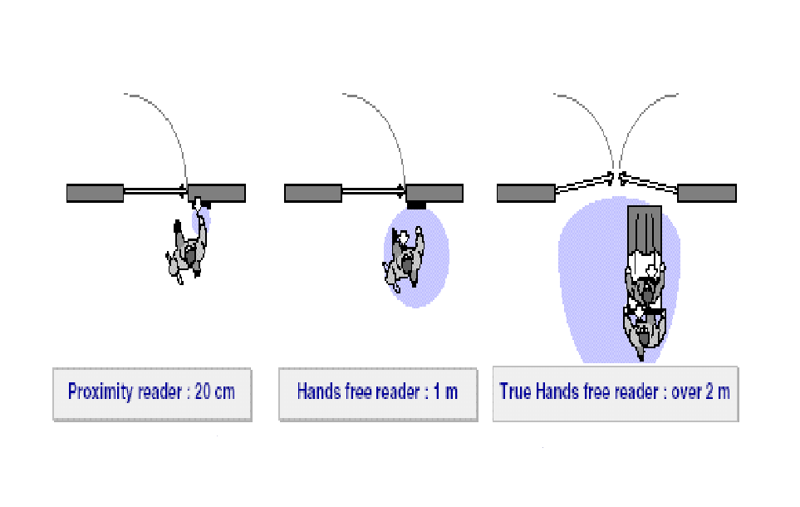
Proximity vs Long range RFID
Proximity
Long Range contact less

Slide 11
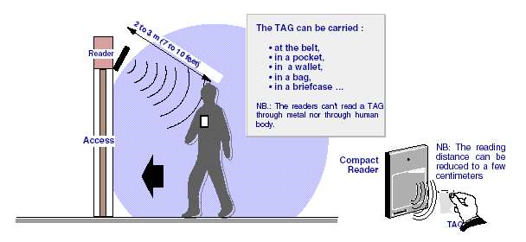
Pedestrian Tracking at Building Entrances

Slide 12
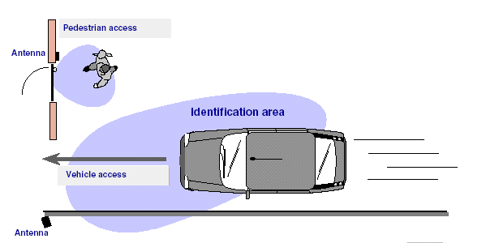
Vehicle & Pedestrian Access at Gates

Slide 13
RFID Components
Reader (including the antenna)
  Used to read and/or write data to the RFID tags
RFID Tag
  Transmits data to the reader
Controller
  It provides a means of communicating the data to a host computer or information management system
Host system
  Centralized or Distributed

Slide 14
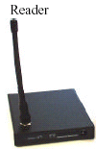
RFID Network Connectivity Diagram
RS-422/RS-232/
TCP/IP
RS-422/RS-232
TCP/IP
TCP/IP
TCP/IP
Campus LAN
Building#n
Building#1
TCP/IP
Appl Server
Control Room

Slide 15
Automated Access Control
  Using Biometric (Finger Prints)‏

Slide 16
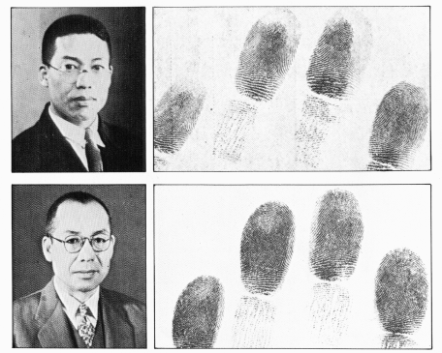
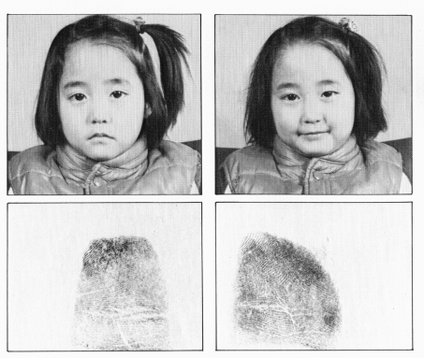
Fingerprints as Identification..
Fingerprints are unique
  For each individual
  For each finger
Also unique in case of twins
Fingerprint uniqueness is maintained from birth to death
Fingerprints can also be used to prevent various kinds of fraud involving false identity

Slide 17
Fingerprints as Identification..
Confirms Positive Identity
  Photographs & Signatures can be forged
  Password & Secret Numbers can be stolen or revealed under force
Photo
Password
Signature

Slide 18
Fingerprints as Identification..
Retina, Voice, Hand Geometry, DNA etc. have accuracy problems and/or under research
Fingerprints have been used for solving crime by police for over 100 years
Biometric
Fingerprint
Hand Geo
Retina
Voice
DNA

Slide 19
Automated Access Control
  Using Smartcard

Slide 20
Smart Cards
Similar in appearance to credit card
Embedded Integrated Chip
  Micro controller Chip: It allows to make computations, decisions and manipulate data
  Memory Chip: can be either a memory chip with non-programmable logic or a microprocessor with internal memory

Slide 21
Smart Cards
Comes in two variety
  Memory Card
  Microprocessor Card

Slide 22
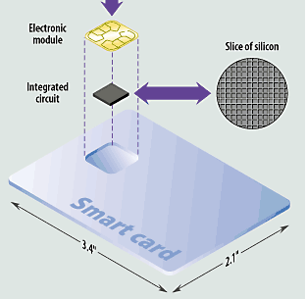
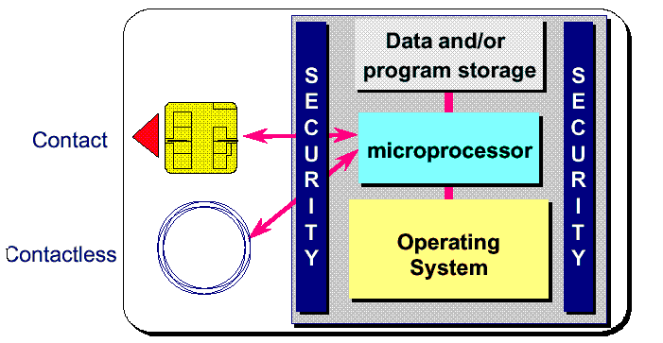
Smart Card Resources

Slide 23
Smart card Applications
Government Applications
  Identification Applications
  Driving License
  Health care
Enterprise Security & Communication
  ID cards & Access Applications
  Securing Information
Payment Applications
  Loyalty & Stored Value
  E-Commerce
  Personal Finance
Integrated & Customized Services

Slide 24
Investor Verification
Investor
POS/ Broker
The investor approaches Broker along with ID card
1
Brokers verifies the identity and if satisfied then he allows investor to transact
3
Verification Counter
2
The officer at the counter verifies the investor identity
based on: Photo, Unique ID & Signature during a Transaction
In case of not satisfied with these verifications, he will verify the Investor Finger Prints (FP)

Slide 25
Members Registration
Member
EPF Office
Member approaches EPF office to register
1
Issues Social Security Number (SSN)‏
3
Registration Counter
2
Step 1: Captures the members details: Photograph, Personal details & Finger Print(FP).
Step 2: Based on the personal details, software generates a
base code & verifies its uniqueness.
Step 3: If unique,stores it along with FP.
Step 4: If FP matches then registration is denied; if not, the FP is
stored & final security profile is generated.

Slide 26

Access Control using Smartcard
Telecom
SIM,
Pre-paid
Transport
Toll Management
Ticketing
DL, Permits
Emerging
Physical / Virtual Security
Pay TV, Townships
Multi-applications
Health
Health Records
Insurance
E&M-Commerce
Authentication &
Authorization
E-Payments
Retail
Loyalty
Customer payments
IDentity
Banking
National ID
Employee Management
PAN
Credit cards
Debit cards
Electronic Cheque

Slide 27
Potential Applications
Network Access/Authentication
  Password reset and lockouts
Portable biometric key for facilities access control
PC/Laptop lockdown
Secure, Instant VPN/Messaging
Secure PDA messaging
  Hardware token inserts in PDA
  All users authenticated
  Point to Point encryption for all messages

Slide 28
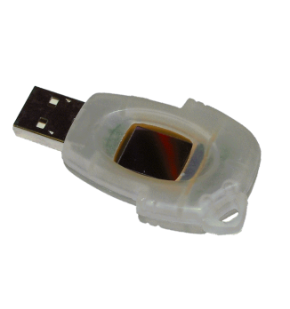
Multi factor Authentication
4 Factor authentication System
Strong Authentication using multi-factor Challenge/ Response System
  Something you have
  Something you are
  Something you know
  Something you validate

Slide 29
Identification: Biometric Matching In Multiple Modes
Biometric signature is stored on the chip
Biometric data and signatures are encrypted before it leaves the chip
Matching algorithms can be implemented on several modes:
  In Host; or
  In Device (POS, Door controllers); or
  On Chip

Slide 30
Surveillance System
  CCTV
  Sensors
  Metal Detectors

Slide 31
CCTV
Stand alone traditional camera
Remote Controlled Camera
IP Camera
  Fixed Focus
  PTZ (Pan-Tilt-Zoom)‏
Recorders (Video Servers)‏
  Time Stamping
  Search Facility

Slide 32
Sensors
Motion Sensors
  Mechanical
  Optical
Vibration Sensors
Thermal Sensors

Slide 33
Security Mechanisms - Cyber
  Network
  Host
  Application
  Other Mechanisms

Slide 34
Security Mechanisms - Network
Firewall
  Host
  Network

Slide 35
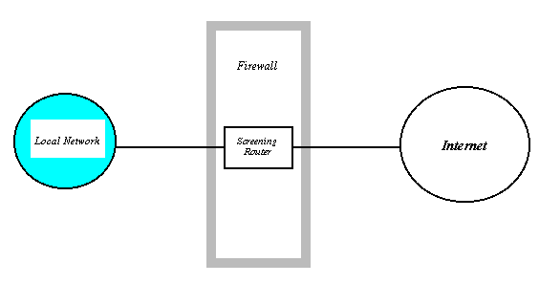
Firewall

Slide 36
General Firewall Techniques
Service Control
Direction Control
User Control
Time Control
Behavior Control

Slide 37
Firewall Requirements
Itself immune to penetration
Use secure OS
Presence Undetected by Outsiders

Slide 38
Types of Firewall
Host Firewall
Network Firewall
Packet Filtering Firewall
Application Proxy Firewall
Software Firewall
Hardware Firewall

Slide 39
Host Firewall
Software based
Protects a single host
Can be highly customised
Dependent on host OS
Affected by host OS

Slide 40
Network Firewall
Protects a subnet
Has to be as generic as possible
Independent of host OS
Can be software or hardware based
Stealth Mode

Slide 41
Filtering Routers or Screening Router
What does a filtering router do?
  Performs packet filtering in addition to routing function.
  Before consulting the routing table it decides whether the packet should be forwarded towards its destination.

Slide 42
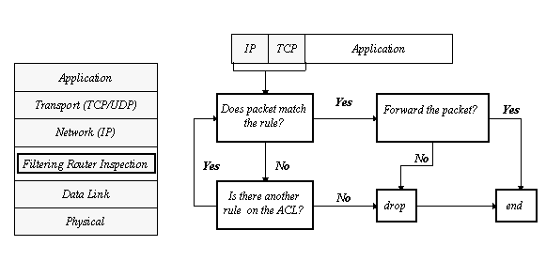
Filtering Routers

Slide 43
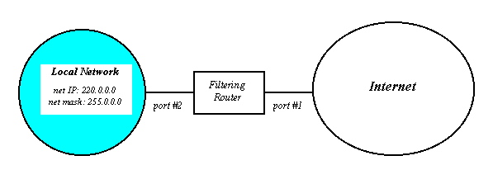
Filtering Routers

Slide 44
Filtering Routers
How does it do its job?
  Filtering is made using an Access Control List (ACL) for each physical interface.
  Each entry in the ACL has values for particular header fields of the packet.
  The action to be taken can be –
    To permit what is not explicitly prohibited.
    To prohibit what is not explicitly permitted.

Slide 45
Filtering Routers
How are filtering decisions made?
  The protocol headers of IP, TCP or UDP are examined for –
    Source IP, Destination IP address
    Protocol Type (Transport Layer)‏
    TCP/UDP Port (Applications)

Slide 46
Filtering Routers
Advantage
  Simple
  Transparent to users
  Fast

Slide 47
Filtering Routers
Are filtering routers not enough?
  For protocols that require setup of inbound connections, we must give access to all ports on the local host to the Internet.

Slide 48
Filtering Routers
Possible attacks on Filtering Router
  IP address spoofing
  Source Routing attacks
  Tiny fragment attacks

Slide 49
Application Gateways or Proxies
What is a proxy?
  Doesn’t allow direct connection between client on the Local Network & server on the Internet or vice versa.
  Relays traffic between actual client and actual server while doing checks and access controls that typical client and server software do not support.

Slide 50
Application Proxies
How proxy program works?
  Accept client sessions and appear to them as a server.
  Receive name of actual server from client.
  Contact actual server and appear as client.
  Relay all the data from client to a server.
  Perform access control according to the site’s Security Policy.

Slide 51
Application Proxies
How internal client is enforced to contact proxy server?
  Classical proxy technology - Client s/w is modified or user follows special setup procedures.
  Transparent proxy technology - Routing tables of the Local Network are so configured that all packets for external servers come to proxy server.

Slide 52
Application Proxies
Characteristics
  More secure
  Easy to log the connections
  Better auditing possible
  Additional processing overheads
  Slower

Slide 53
What are the different firewall architectures?
Screening router firewall
Dual homed host firewall
Screened host firewall
Screened subnet firewall

Slide 54
Screening router firewall

Slide 55
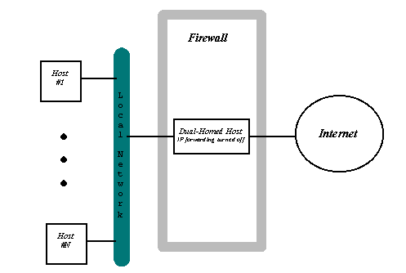
Dual homed host firewall

Slide 56
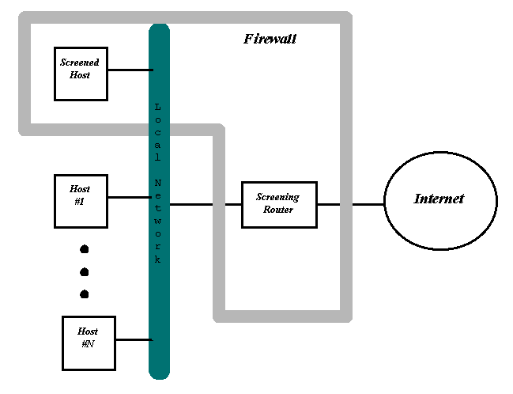
Screened host firewall

Slide 57
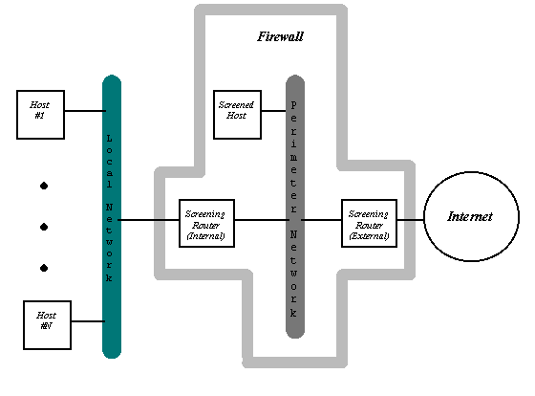
Screened subnet firewall

Slide 58
Commercial Firewall Products
Checkpoint
Cisco
Fortigate
Netgate
McAfee
Sophos
SonicWall
Cyberguard, etc.

Slide 59
Security Mechanisms - Network
Firewall
  Host
  Network
Intrusion Detection System (IDS)‏
  Host
  Network

Slide 60
Intrusion Detection System

Slide 61
Definition and Needs
IDS = Intrusion Detection System
Not firewall
Content inspection at protocol level

Slide 62
Technology
Signature detection
Anomaly detection

Slide 63
General IDS Model
Sensor
Analyzer
Manager
Administrator
Operator

Slide 64
Basic Classification
NIDS - Network Based
  e.g. Cisco Secure IDS , Axent Netpowler, Snort, ISS RealSecure Network Sensor, NAI Cybercop Monitor
HIDS - Host Based
  e.g. Axent Intruder Alert, ISS RealSecure OS Sensor, Tripwire

Slide 65
Host Based IDS
Corporate
Network
Agent
Agent
Agent
Firewall
Untrusted
Network
Agent
Agent
Agent
Agent
Agent
Agent
WWW
Server
DNS
Server

Slide 66
Network Based IDS
Corporate
Network
Sensor
Sensor
Firewall
Untrusted
Network
Director
WWW
Server
DNS
Server

Slide 67
Functional Classification
Packet capturing + Pattern matching
Log parser
File integrity checker
Activity monitor

Slide 68
Response Actions (1)‏
Log
Alert
  Console
  Email
  SNMP Traps

Slide 69
Response Actions (2)‏
Termination
  TCP kill
  Kernel drop
Third-party Integration
  Firewall
  Router

Slide 70
Security Mechanisms - Network
Firewall
  Host
  Network
Intrusion Detection System (IDS)‏
  Host
  Network
RAS
L3 Switch
  VLAN
VPN

Slide 71
Remote Access Server
Provides connectivity to dial-in users
Potential security week point
Can be configured for security
  Caller ID
  Dial-back
  Login - Password
  Authentication Protocols
  ACLs

Slide 72
Layer-3 Switch
Divides one physical LAN into multiple VLANs
Keeps broadcast traffic within a VLAN
Restricted access from a VLAN to another VLAN
Users can be dynamically added to a VLAN, irrespective of their physical location
Membership to multiple VLANs

Slide 73
Virtual Private Network
(VPN)‏

Slide 74
What is VPN?
A network over network
A Virtual Private Network (VPN) connects the components and resources of one network over another network with secure transmission

Slide 75
Is VPN New?
PVC
SVC
  X.25
  Frame Relay
TDM

Slide 76
Today’s New Challenges
Business
Partners
Very
Remote
Office
Main
Office
?
?
?
1000s of Remote
Workers
Private Line Network
Remote
Office
Regional
Office
Home
Offices
Mobile
Workers

Slide 77
Need for VPN
Cost
Moving Workforce
Dynamic Business Relations
Flexibility of Operation
Fast Deployment

Slide 78

VPNs Extend the Classic WAN
Analog
ISDN
RAS
Dial-in
RAS
Internet
RAS
Frame Relay
Broadband
Cable, DSL

Slide 79
Definition of VPN
Mobile
User
Analog
ISDN
Cable
Remote
Site
Server
Internet
Remote
Site
“A Virtual Private Network (VPN) connects the components and resources of one network over another network with secure transmission.”

Slide 80
Virtual Private Networks
Intranet VPN
Low cost, tunneled connections with rich VPN services, like IPSec encryption and QoS to ensure reliable throughput
Cost savings over Frame Relay & Leased Lines
Home
Office
Main
Office
POP
Remote
Office
VPN
POP
Remote Access VPN
Secure, scalable, encrypted tunnels across a public network, client software
Cost Savings over toll-free # expenditures
Extranet VPN
Extends WANs to business partners
Safe L3 Security
Business
Partner
Mobile
Worker

Slide 81
VPNs Come in Many Flavors
Intranet VPN
Extranet VPN
Layer 2
Layer 3
FR
ATM
Internet VPN
IP VPN

Slide 82
VPNs - Who Does What
Enterprise Managed
Service Provider Managed
Internet
VPN
IP
VPN
Service Provider provides basic VPN connectivity
Enterprise manages QoS, security, SLA, and configuration of VPN functions
Service Provider provides turn-key VPN
Enterprise outsources design, provisioning and management
Enterprise controls security

Slide 83
VPN Critical Functions
Accessibility
User Authentication
Confidentiality
Data Authenticity

Slide 84
Password-Based Authentication
RADIUS
Server
NT
Server
Internal
Internet
SecurID
Server
Authentication
Servers
Authentication
Protocols

Slide 85
Client Authentication Protocols
Password Authentication Protocol (PAP)‏
Challenge Handshake Authentication Protocol (CHAP)‏
MS-CHAP
IPSec

Slide 86
User Authentication Servers
RADIUS
Server
Internal
NT
Server
SecurID
Server
External
External Authentication
  RADIUS
  SecureID
  NT Server
Internal Authentication
  VPN Device

Slide 87
Certificate-Based Authentication
Certificate Authority
Trusted Third Party
Request
Certificate
Request
Certificate
Issue
Certificates
Exchange Certificates

Slide 88
VPN Tunneling
Corporate Office
Remote Office
Server
Internet
Tunnel
Envelop

Slide 89
VPN Tunnel Types
Client to LAN
Server
Internet
Modem
ISDN
Cable
DSL
Client
Tunnel
LAN to LAN
Server
Internet
Tunnel

Slide 90
Encryption Alternatives
Application
Layers (5-7)‏
Application-Layer Encryption
Network-Layer Encryption
Transport/
Network
Layers (3-4)‏
Link/Physical
Layers (1-2)‏
Link-Layer
Encryption
Link-Layer
Encryption

Slide 91
VPN Designs
DMZ
Firewall
Router
Corporate
Internet or ISP Backbone
VPN Concentrator
AAA/DHCP
CA
Extranet

Slide 92
Alternative Design (not recommended)‏
Corporate
Internet or ISP Backbone
Firewall
VPN Concentrator
Router

Slide 93
Alternative Design
Firewall
Internet or ISP Backbone
Corporate
Router
VPN Concentrator

Slide 94
Security-Based Designs
VPN Firewall
Corporate
Internet or ISP Backbone
Router
Firewall
Corporate
Internet or ISP Backbone
Router
Secured VPN Traffic

Slide 95
Network Security Analysis Tools
Sniffers
Protocol Analysers
Scanners
Log Analysers
Password Crackers

Slide 96
Security Mechanisms - Others
Encryption Tools
Authentication Servers
Biometric Authentication Devices
Public Key Infrastructure (PKI)‏
  Directory Servers
  Certificate Server
NMS
Network Forensics

Slide 97
Security Mechanisms - Others
Application Proxy Servers
  Forward Proxy
  Reverse Proxy
Virus Scanners
  Personal
  Gateway
Content Screening Software

Slide 98
Questions & Answers Session

